Slide 1
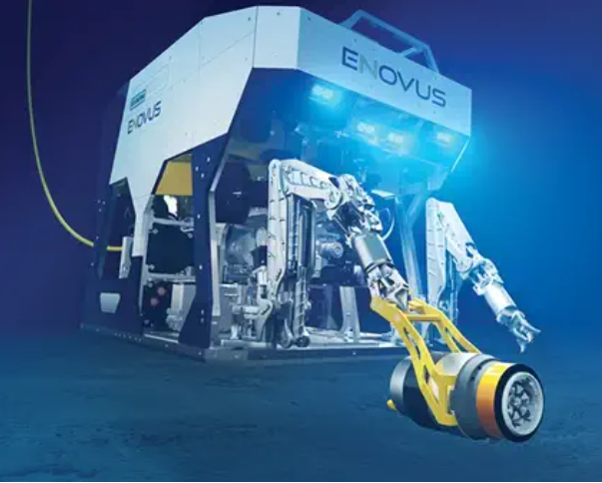
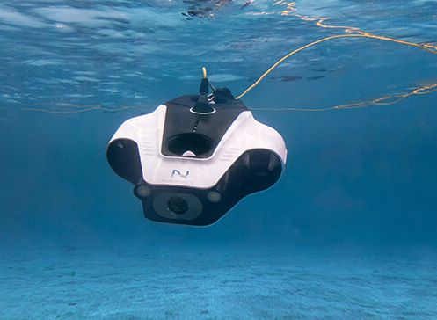
ROBOTIC HARDWARE SYSTEM
ROBOT TYPE: REMOTELY OPERATED UNDERWATER VEHICLE(ROV)
NAME: MOHAMAD LUQMAN IDLAN BIN MOHAMAD AZAHARI
MATRIC: 1723539

Slide 2
MAIN COMPONENTS
1. DESIGN
2. DRIVING SYSTEM
3. NAVIGATION AND CONTROL SYSTEM
4. DATA TRANSMISSION AND COLLECTION
5. POWER MANAGEMENT

Slide 3
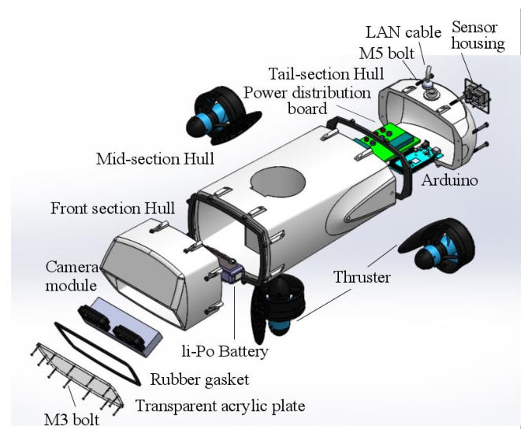
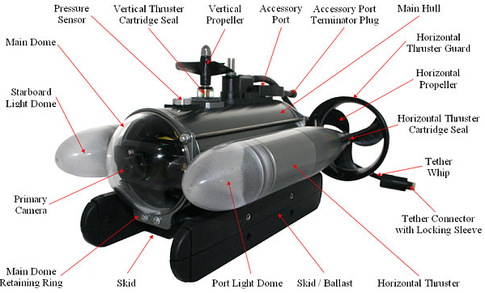
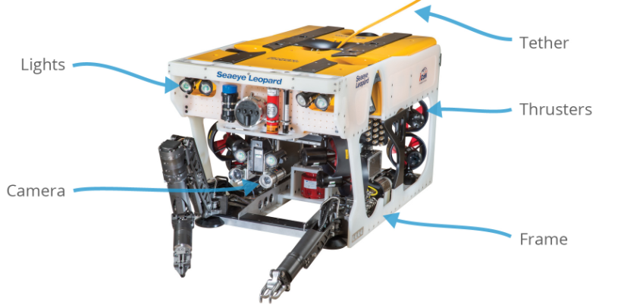
DESIGN

Slide 4
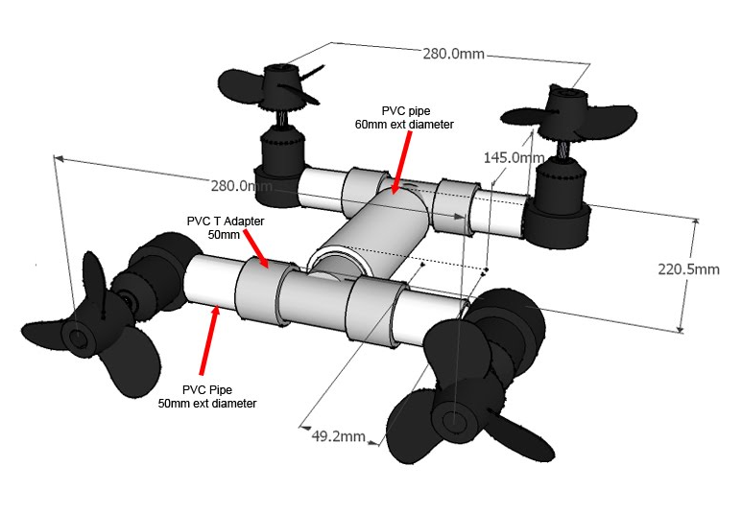
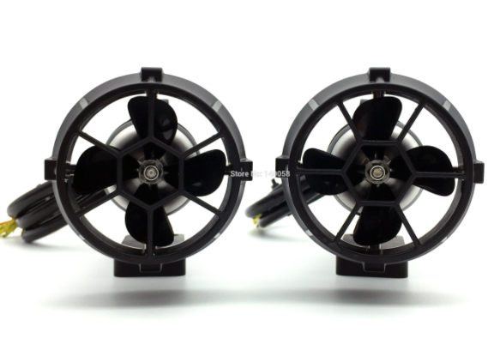
DRIVING SYSTEM
ROV propulsion systems come in three different types: Electrical, hydraulic, and ducted jet propulsion.
The main goal for the design of ROV propulsion systems is to have high thrust-to-physical size/drag and power-input ratios.
The more powerful the propulsion of the ROV, the stronger the sea current in which the vehicle can operate.

Slide 5
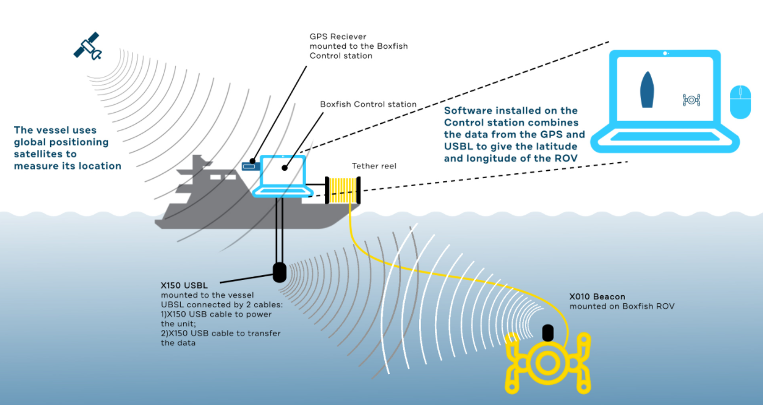
NAVIGATION AND CONTROL SYSTEM
The USBL system consists of two main parts: a USBL transponder and a beacon. The USBL transponder is mounted or suspended from your vessel and communicates with the beacon on the Boxfish ROV wirelessly using high-frequency sound waves.
The USBL transponder periodically transmits commands to the beacon, which the beacon will immediately reply to upon receiving. The USBL transponder can then measure the response time and returning signal direction to calculate the ROV’s 3D position relative to the boat
Schematic principle of Boxfish navigation system.

Slide 6
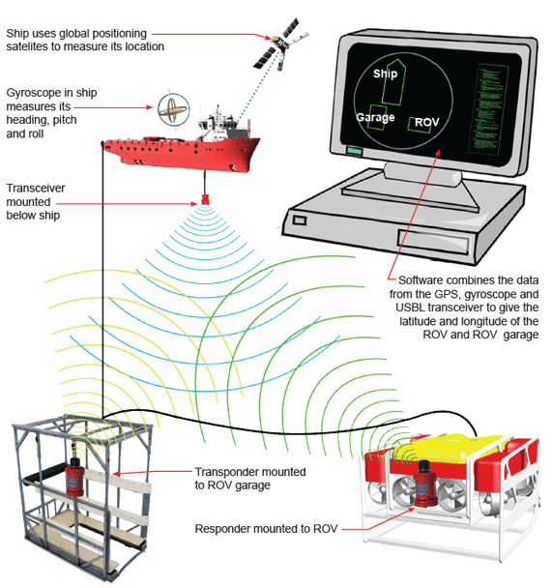
Open Water Positioning: Ultra Short Baseline Acoustic Positioning (USBL)
USBL is a means of providing a position of the ROV using acoustic positioning. It works by using a Differential Global Positioning System (DGPS) derived position and an accurate heading, pitch, roll and heave sensor to position a transceiver carried on a vessel on the surface

Slide 7
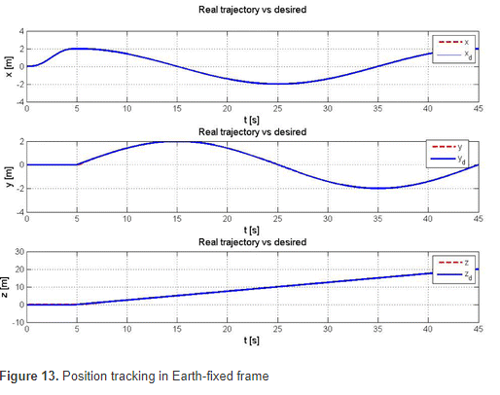
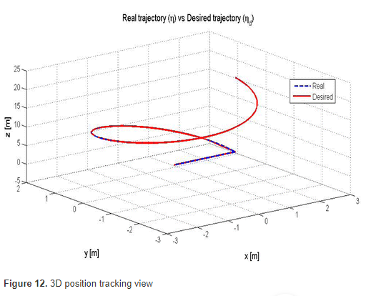
ROV Trajectory
The trajectory in 3D that Kaxan robot follows.

Slide 8
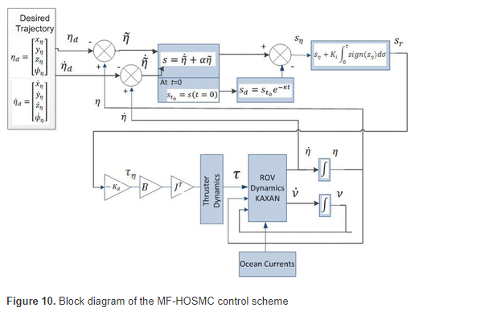
DATA TRANSMISSION AND COLLECTION
Control design of the system is derived by the equation

Slide 9
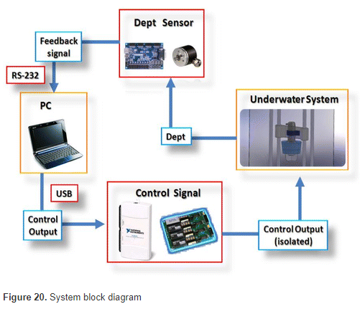
Data Transmission of ROV
The control software was developed in LabVIEW platform from National Instruments.

Slide 10
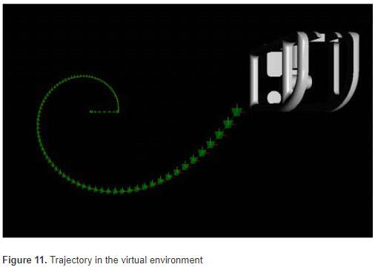
Virtual Environment
In order to give more realism to the simulation, a 3D virtual reality environment was developed. The software developed on MATLAB/Simulink has useful tools for virtual reality programming, like Virtual Reality Toolbox and V-Realm Builder

Slide 11
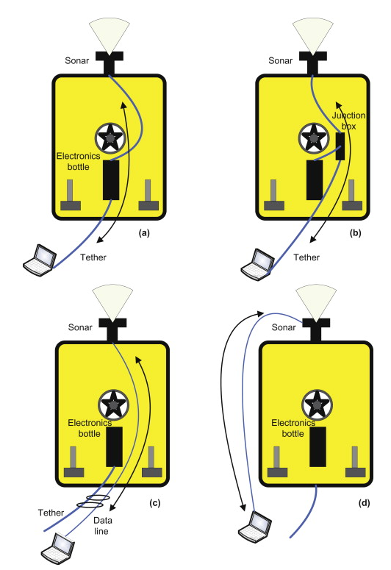
ROV-mounted sensors communicate with the surface through four separate modes
2.
Communication through the vehicle’s tether but bypassing the telemetry system
1.
Communication through the vehicle’s tether and telemetry system
3.
Communication outside of yet attached to the vehicle
4.
Communication separate and apart from the vehicle

Slide 12
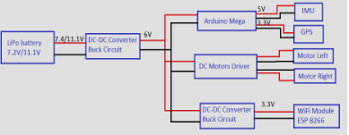
POWER MANAGEMENT
The ROV components is powered from 7.2V and 2200mAh Lithium Polymer battery using a DC-DC converter which lowers the voltage to 6V
The Arduino pins can provide up to 40mA so we can power the IMU and GPS modules directly from the 5V and 3.3V pins, but for the DC motors and the WiFi module it’s necessary external power supply. Motor Driver use the same voltage as Arduino board. An DC-DC converter reduce the voltage from 6V to 3.3V (0.7A) for the WiFi module.
power supply system of ROV

